Slide 1
Introducing Vistara 3.0
Hybrid IT Service Management for the Cloud
Eric Krock
Director of Product Marketing, Vistara
The IT Operations Cloud
2013-04-23

Slide 2
Agenda
Modern IT: hybrid cloud, hybrid IT, and hybrid service management requirements
How Vistara 3.0 addresses these needs
Demo
Q&A

Slide 3

What is the Hybrid Cloud?
“Hybrid cloud computing is the coordinated use of cloud services across isolation and provider boundaries …. between internal and external cloud services.”
Thomas Bittman and David Cearley, Gartner Inc., “Get Past the Confusion Surrounding Hybrid Cloud Computing,” 22 Oct 2012.

Slide 4
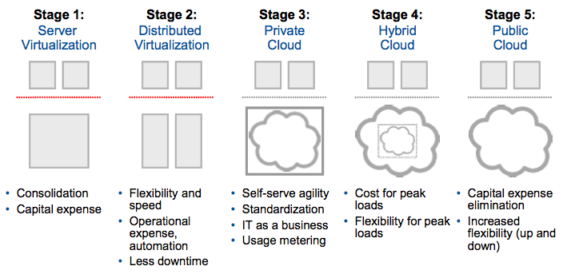
Virtualization Road Map
Thomas Bittman, Gartner Inc., “Design Your Private Cloud With Hybrid in Mind,” 24 Feb 2012

Slide 5
Hybrid Cloud Management Solution Requirements
Manage public and private cloud-hosted elements
Map virtual to physical infrastructure
Map services to supporting elements
Unified monitoring and management interface
Unified alert management across Public and Private Cloud

Slide 6
What is Hybrid IT?
“Hybrid IT is the result of combining internal and external services, usually from a combination of internal and public clouds, in support of various business outcomes.” - Chris Howard et al, Gartner Inc., “Hybrid IT: How Internal and External Cloud Services Are Transforming IT,” 8 Feb 2012

Slide 7
IT’s Role in the Hybrid IT Model
“IT organizations are becoming the broker for a set of IT services that is hosted partially internally and partially externally – a hybrid IT architecture. By being the intermediary for IT services, IT organizations can offer internal customers the price, capacity, and speed of provisioning of the external cloud, while maintaining the security and governance the company requires and reducing IT service costs.” - Chris Howard et al, Gartner Inc., “Hybrid IT: How Internal and External Cloud Services Are Transforming IT,” 8 Feb 2012

Slide 8
IT Responsibilities in Hybrid IT
Trusted evaluator and approver of services
Managing internal services
Governing all services
SLA definition
SLA monitoring and management
Identity management
Data management policy

Slide 9
Additional Metrics to Consider for Cloud Services
Agility: Can IT service respond in real-time to changes in demand & business needs?
Elasticity: How much can service’s capacity scale upward and downward to match demand?
Continuity: Maximum time between interruptions
Consistency: Can variations in service levels be reduced?
Source: Tapati Bandopadhyay, Gartner Inc., “Business-Aligned Metrics for IT Services in Cloud: Returns on Agility, Elasticity, Continuity and Consistency,” 10 January 2012

Slide 10


Hybrid Service Availability Monitoring
Considerations
Element level availability vs. availability of an entire service
Do you track availability of individual elements or an entire service compose of multiple elements?
Is availability a binary quantity (up / down) or more fine-grained?
How do you account services that are available, but running with degraded redundancy/performance?
Planned downtime vs. unplanned downtime
Do you count downtime due to planned activities (e.g. patching)?
Service to element mapping
Web App
App Server 1
App Server 2
Database

Slide 11
Agenda
Modern IT: hybrid cloud, hybrid IT, and hybrid service management requirements
How Vistara 3.0 addresses these needs
Demo
Q&A

Slide 12
Vistara 3.0 Goals
Enable hybrid IT service monitoring
Unify alert management and monitoring throughout hybrid cloud
Automate alert escalation
Manage assets over their lifecycle
Enable data driven planning and optimization
Report on key IT operations metrics
Notes:
Some of the key themes of 3.0 are enabling customers to realize a customized Enterprise Command Center and delivering enhanced reporting. New 3.0 features fall under on these themes:
Unified Alert Management & Monitoring:
Monitoring an IT service
Automated alert escalation
Enable data driver planning & optimization:
Asset lifecycle management
Reporting on key IT operations metrics
Vistara already supported receiving alerts from Vistara and 3rd party products before 3.0. The above new features complete the Enterprise Command Center theme.

Slide 13
Monitoring an IT Service
Goal
Monitor an IT service composed of multiple components
Features
Service definition
Dynamic, rule-based service membership
Service status visualization
Dashboard
Topology
Web App
App Server 1
App Server 2
Database
Notes:
It’s now possible to define a logical service that’s composed of multiple internal and external infrastructure elements.
The service is defined by rules, which makes it possible for the service’s definition of its constituent elements to be self-updating. For example, if you define a service as being composed of (among other things) all application servers named foosvc-appsvr-*.vistarait.com, as additional servers are added following the name convention, they will automatically be added to the service definition.
Administrators can now visualize a service and its state both with a dashboard view similar to our existing dashboard view for other elements(giving a convenient heads-up display) and with a topology view that maps the service to its constituent elements (making it easy to navigate from the service to its supporting elements).

Slide 14
Monitoring an IT Service: Setup
Monitor an IT service composed of multiple components
Service level availability based on component servers and their dependencies.
Group multiple devices using TAGs. Define services based on TAG definition.
Services can contain Services & TAGs as members
Group level Templates can be applied at TAG level. Service App Monitors will act on existing monitors based on consolidation function.
AND supported as a connector

Slide 15
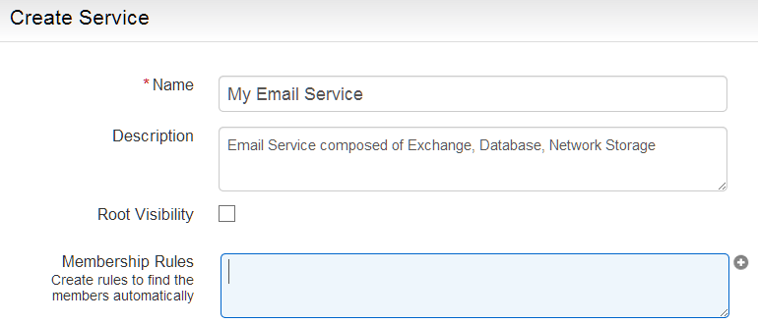
Monitoring an IT Service: Setup
Notes:
This is the screen where you enter the configuration rules to define the constituent elements that make it up.

Slide 16
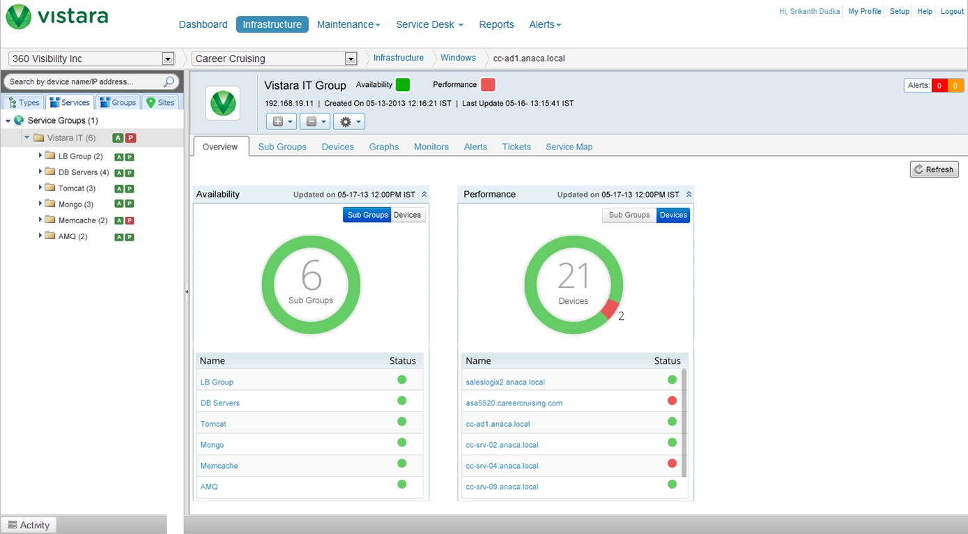
Monitoring an IT Service: Custom Dashboard
Notes:
Service monitoring and management dashboard.

Slide 17
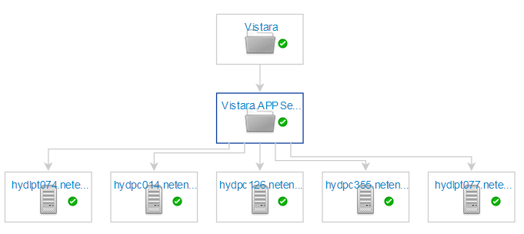
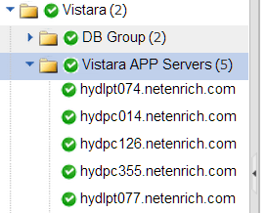
Monitoring an IT Service: Dependency Map
Notes:
Service topology view showing mapping of service to constituent elements.

Slide 18
Monitoring Enterprise Applications
Built-in templates for monitoring:
Microsoft Active Directory
Microsoft Exchange
SQLServer
Internet Information Server
MySQL

Slide 19
Alert Escalation
Goal
Notify the right people at the right time about critical alerts
Features
Escalation Schedule
Define who is on duty, when
Plan escalation coverage
Escalation Matrix
Define escalation chain of users to notify
Alert
Email
Level 1
Level 3
Level 3
Notes:
You can now define a rule-based alert escalation system. Recipients can be notified by email according to the defined rules.

Slide 20
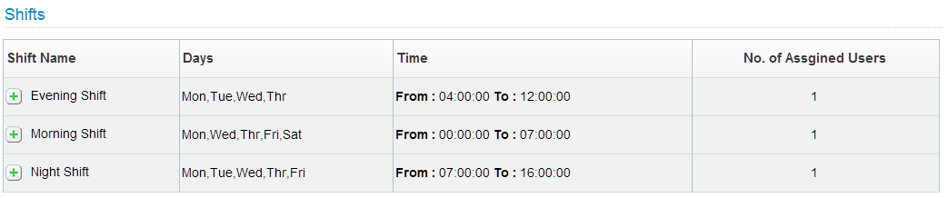
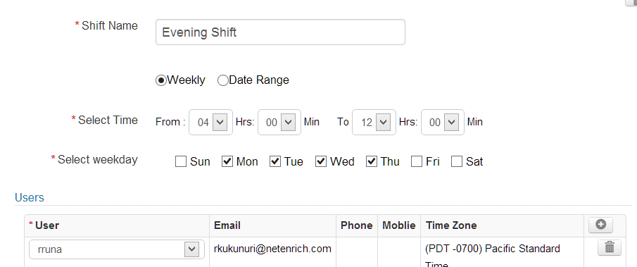
Alert Escalation: Setup
Notes:
Alert schedule rule definition screen.

Slide 21
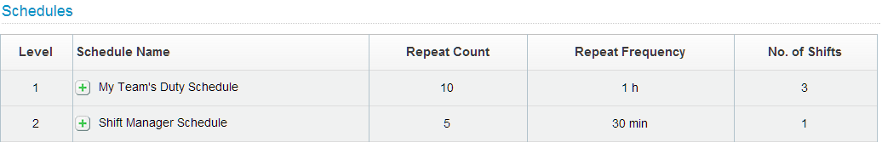
Alert Escalation
Notes:
You can also specify the number of times a notification associated with a particular schedule should be repeated before it ceases and the frequency the notification should occur. You can also define the number of shifts associated with that schedule. You can define multiple shifts per escalation schedule – morning, evening, night, etc.

Slide 22
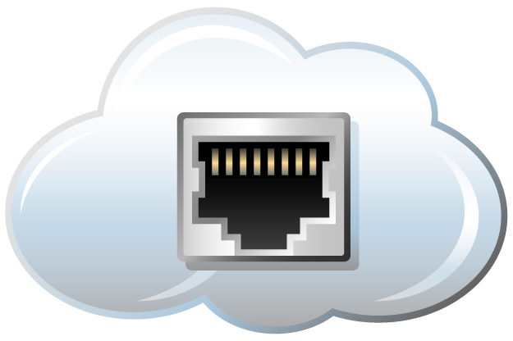
Asset Management
Goal
Single source of truth for hardware asset state
Ownership, Location
Warranty and Support Contracts
Operational State: Deployed, In Repair, …
Features
Asset Metadata
Asset Attributes
Owner, Operational State
Contract
Maintain Warranty, Support Information
Data Connectors
Synchronize with multiple sources of asset information across the enterprise
Data connectors for Active Directory, CSV, SQL
Asset Reports
Shipping & Receiving
(e.g. Barcode Scanner)
Procurement (e.g. Oracle)
Active Directory
Notes:
Vistara 3.0 adds support for basic asset management across the lifecycle.

Slide 23
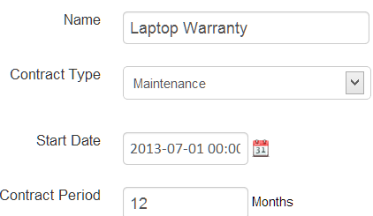
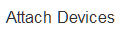
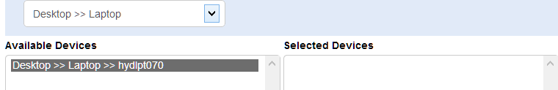
Asset Management
Notes:
This is the screen on which the administrator associates specific devices with the warranty contract governing them.

Slide 24
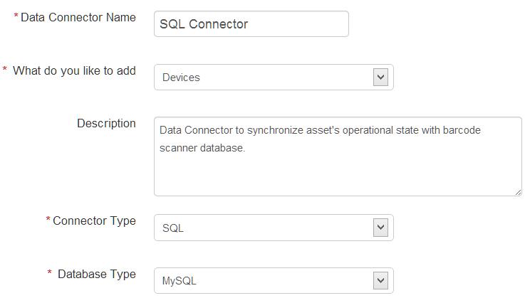
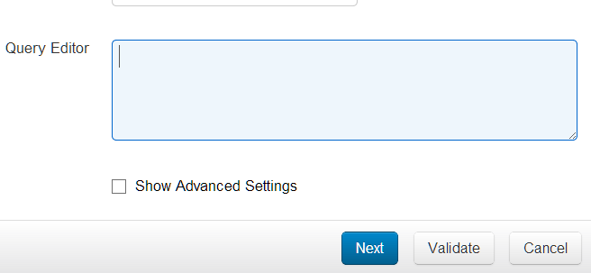
Asset Management: Data Connectors
Notes:
Vistara supports data connectors that synchronize Vistara’s asset information with external sources of asset information – such as ordering systems (Oracle), barcode scanner databases, etc.

Slide 25
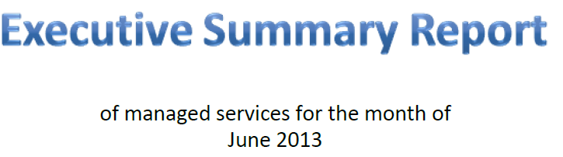
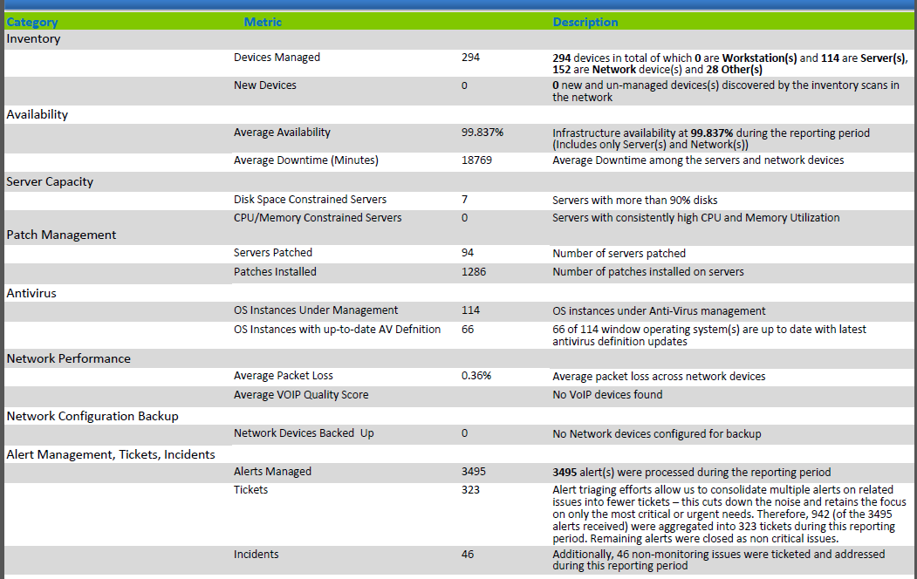
Executive Summary Report
Notes:
Vistara provides comprehensive reports that provide key operational metrics to give into current state, systemic issues, and opportunities for proactive problem prevention, and optimization.

Slide 26
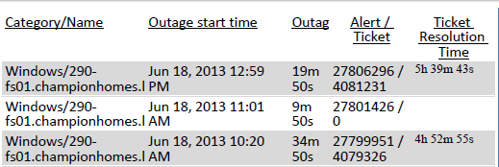
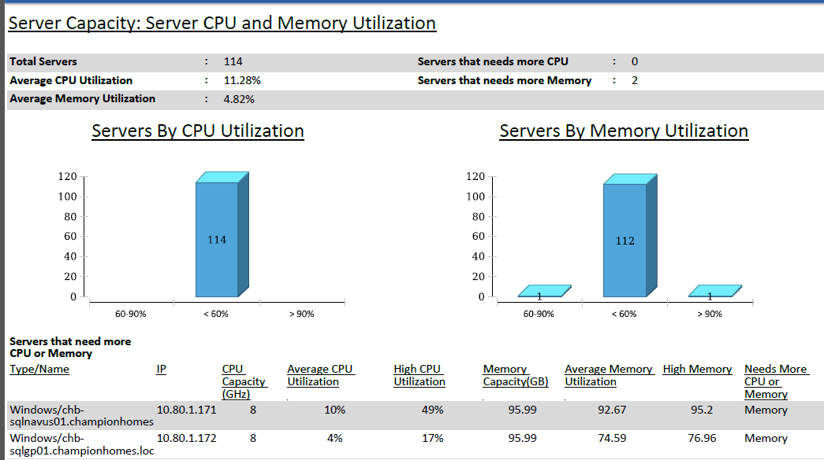
Executive Summary Report
Notes:
This report section shows capacity utilization of your servers. This chart shows if you have servers that are under or over-utilized.

Slide 27
Agenda
Modern IT: hybrid cloud, hybrid IT, and hybrid service management requirements
How Vistara 3.0 addresses these needs
Demo
Q&A

Slide 28
Agenda
Modern IT: hybrid cloud, hybrid IT, and hybrid service management requirements
How Vistara 3.0 addresses these needs
Demo
Q&A

Slide 29

Let’s Get Started Today
Schedule a Demo!
Attend Our Next Webinars!
Email
sales@vistarait.com
Website
www.vistarait.com

